Slide 1
Accessing I/O Devices

Slide 2
Single Bus
Processor
Memory
Bus
I/O de
vice 1
I/O de
vice
n
Figure 4.1. A single-bus structure.

Slide 3
Memory-Mapped I/O
When I/O devices and the memory share the same address space, the arrangement is called memory-mapped I/O.
Any machine instruction that can access memory can be used to transfer data to or from an I/O device.
Move DATAIN, R0
Move R0, DATAOUT
Some processors have special In and Out instructions to perform I/O transfer.

Slide 4
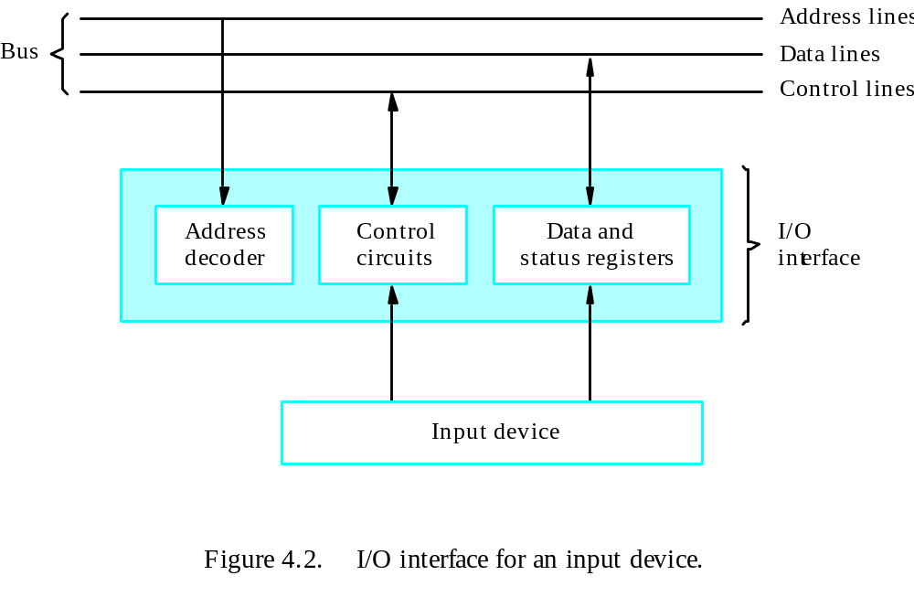
Interface

Slide 5
Program-Controlled I/O
I/O devices operate at speeds that are very much different from that of the processor.
Keyboard, for example, is very slow.
It needs to make sure that only after a character is available in the input buffer of the keyboard interface; also, this character must be read only once.

Slide 6
Three Major Mechanisms
Program-controlled I/O – processor polls the device.
Interrupt
Direct Memory Access (DMA)

Slide 7
Interrupts

Slide 8
Overview
In program-controlled I/O, the program enters a wait loop in which it repeatedly tests the device status. During the period, the processor is not performing any useful computation.
However, in many situations other tasks can be performed while waiting for an I/O device to become ready.
Let the device alert the processor.

Slide 9
Enabling and Disabling Interrupts
Since the interrupt request can come at any time, it may alter the sequence of events from that envisaged by the programmer.
Interrupts must be controlled.

Slide 10
Enabling and Disabling Interrupts
The interrupt request signal will be active until it learns that the processor has responded to its request. This must be handled to avoid successive interruptions.
Let the interrupt be disabled/enabled in the interrupt-service routine.
Let the processor automatically disable interrupts before starting the execution of the interrupt-service routine.

Slide 11
Handling Multiple Devices
How can the processor recognize the device requesting an interrupt?
Given that different devices are likely to require different interrupt-service routines, how can the processor obtain the starting address of the appropriate routine in each case?
(Vectored interrupts)
Should a device be allowed to interrupt the processor while another interrupt is being serviced?
(Interrupt nesting)
How should two or more simultaneous interrupt requests be handled?
(Daisy-chain)

Slide 12
Vectored Interrupts
A device requesting an interrupt can identify itself by sending a special code to the processor over the bus.
Interrupt vector
Avoid bus collision

Slide 13
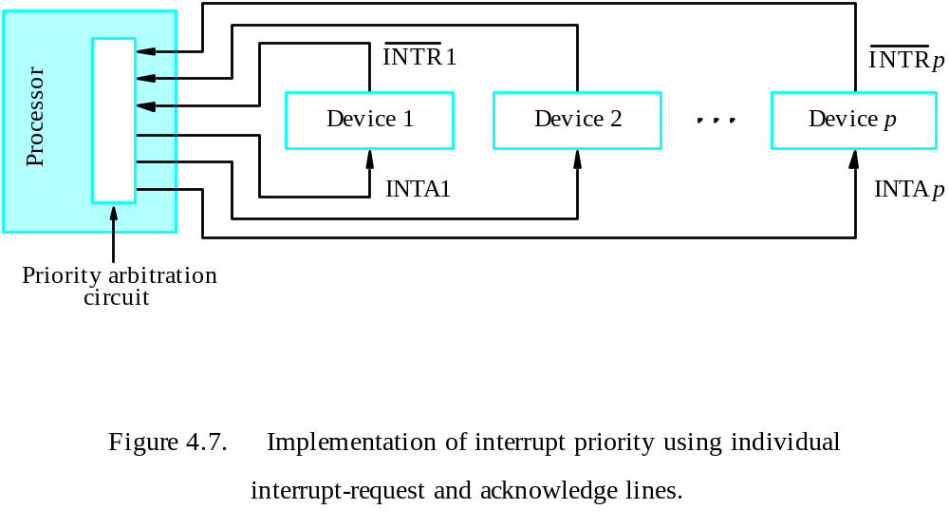
Interrupt Nesting
Simple solution: only accept one interrupt at a time, then disable all others.
Problem: some interrupts cannot be held too long.
Priority structure

Slide 14
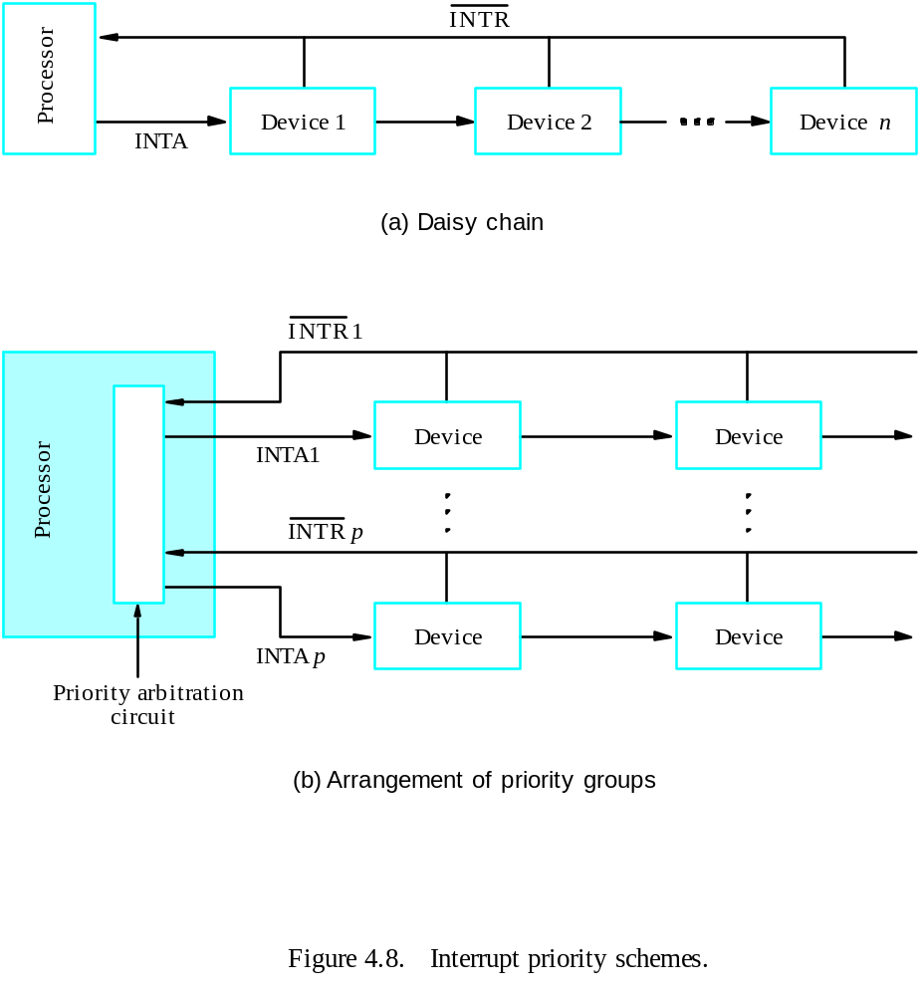
Simultaneous Requests

Slide 15
Controlling Device Requests
Some I/O devices may not be allowed to issue interrupt requests to the processor.
At device end, an interrupt-enable bit in a control register determines whether the device is allowed to generate an interrupt request.
At processor end, either an interrupt enable bit in the PS register or a priority structure determines whether a given interrupt request will be accepted.

Slide 16
Use of Interrupts in Operating Systems
The OS and the application program pass control back and forth using software interrupts.
Supervisor mode / user mode
Multitasking (time-slicing)
Process – running, runnable, blocked
Program state

Slide 17
Processor Examples

Slide 18
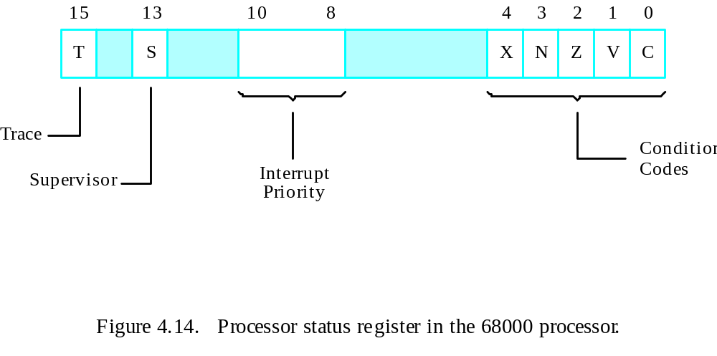

Slide 19
Main
program
MO
VE.L
#LINE,PNTR
Initialize
buffer
p
oin
ter.
CLR
EOL
Clear
end-of-line
indicator.
ORI.B
#4,CONTR
OL
Set
bit
KEN.
MO
VE
#$100,SR
Set
pro
cessor
priorit
y
to
1.
.
.
.
In
terrupt-service
routine
READ
MO
VEM.L
A0/D0,
–
(A7)
Sa
v
e
registers
A0,
D0
on
stac
k.
MO
VEA.L
PNTR,A0
Load
address
p
oin
ter.
MO
VE.B
D
A
T
AIN,D0
Get
input
c
haracter.
MO
VE.B
D0,(A0)+
Store
it
in
memory
buffer.
MO
VE.L
A0,PNTR
Up
date
p
oin
ter.
CMPI.B
#$0D,D0
Chec
k
if
Carriage
Return.
BNE
R
TRN
MO
VE
#1,EOL
Indicate
end
of
line.
ANDI.B
#$FB,CONTR
OL
Clear
bit
KEN.
R
TRN
MO
VEM.L
(A7)+,A0/D0
Restore
registers
D0,
A0.
R
TE
Figure 4.15. A 68000 interrupt-service routine to read an input line from a keyboard based on Figure 4.9.

Slide 20
Direct Memory Access

Slide 21
DMA
Think about the overhead in both polling and interrupting mechanisms when a large block of data need to be transferred between the processor and the I/O device.
A special control unit may be provided to allow transfer of a block of data directly between an external device and the main memory, without continuous intervention by the processor – direct memory access (DMA).
The DMA controller provides the memory address and all the bus signals needed for data transfer, increment the memory address for successive words, and keep track of the number of transfers.

Slide 22
DMA Procedure
Processor sends the starting address, the number of data, and the direction of transfer to DMA controller.
Processor suspends the application program requesting DMA, starts DMA transfer, and starts another program.
After the DMA transfer is done, DMA controller sends an interrupt signal to the processor.
The processor puts the suspended program in the Runnable state.

Slide 23
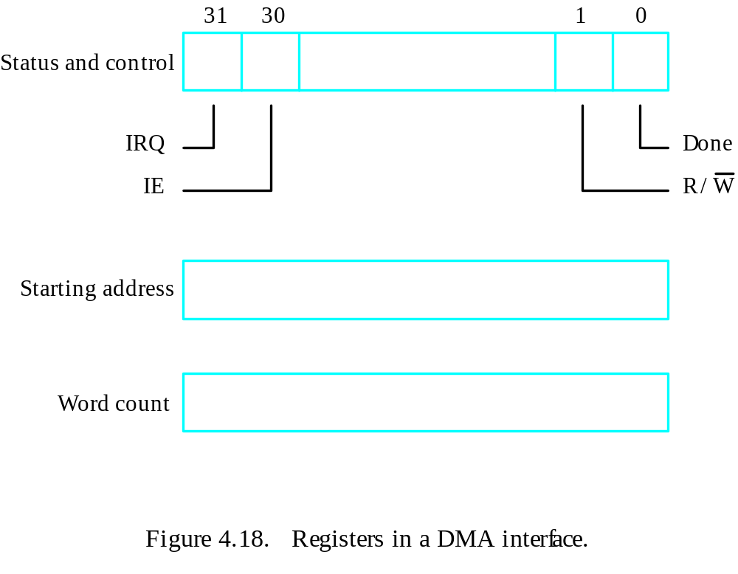
DMA Register

Slide 24
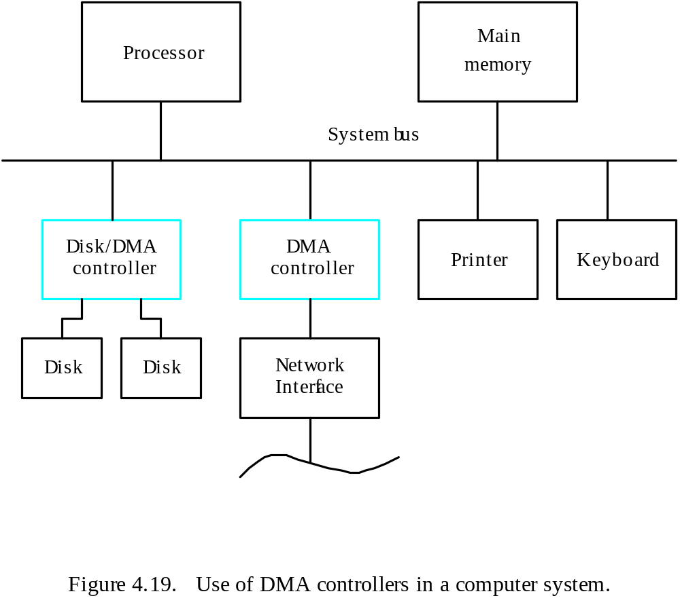
System

Slide 25
Memory Access
Memory access by the processor and the DMA controller are interwoven.
DMA device has higher priority.
Among all DMA requests, top priority is given to high-speed peripherals.
Cycle stealing
Block (burst) mode
Data buffer
Conflicts

Slide 26
Bus Arbitration
The device that is allowed to initiate data transfers on the bus at any given time is called the bus master.
Bus arbitration is the process by which the next device to become the bus master is selected and bus mastership is transferred to it.
Need to establish a priority system.
Two approaches: centralized and distributed

Slide 27
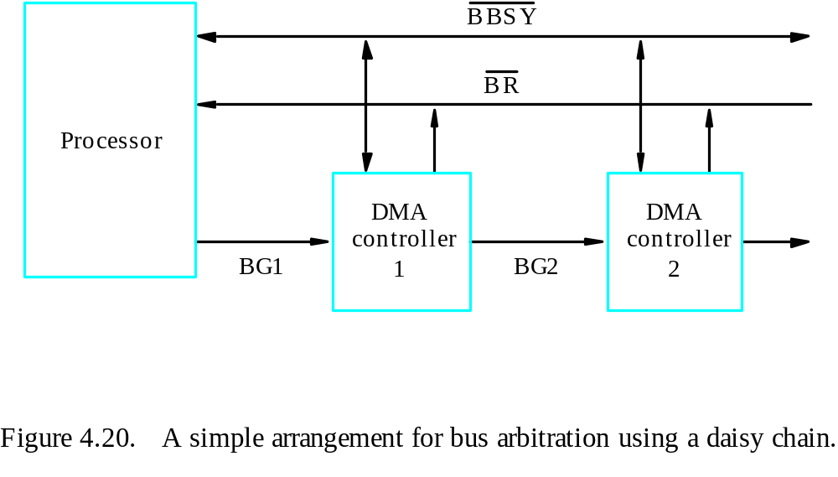
Centralized Arbitration

Slide 28
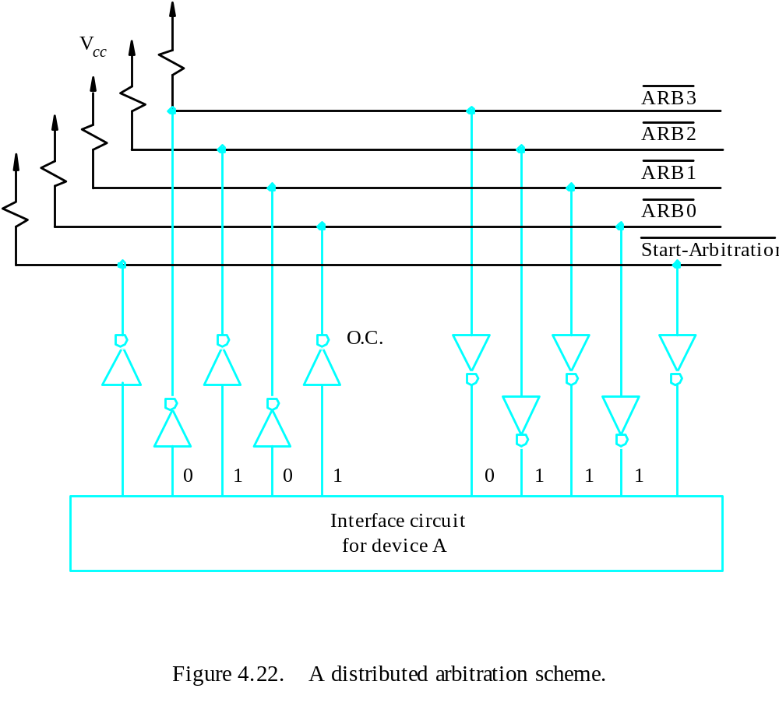
Distributed Arbitration

